Slide 1

July 6, 2020
Notes:
1
1
Check distro statement before using:
DISTRIBUTION STATEMENT A. Approved for pubic release: distribution is unlimited.
This material is based upon work supported under Air Force Contract No. FA8721-05-C-0002 and/or FA8702-15-D-0001. Any opinions, findings, conclusions or recommendations expressed in this material are those of the author(s) and do not necessarily reflect the views of the U.S. Air Force.
© 2020 Massachusetts Institute of Technology.
Delivered to the U.S. Government with Unlimited Rights, as defined in DFARS Part 252.227-7013 or 7014 (Feb 2014). Notwithstanding any copyright notice, U.S. Government rights in this work are defined by DFARS 252.227-7013 or DFARS 252.227-7014 as detailed above. Use of this work other than as specifically authorized by the U.S. Government may violate any copyrights that exist in this work.

Slide 2
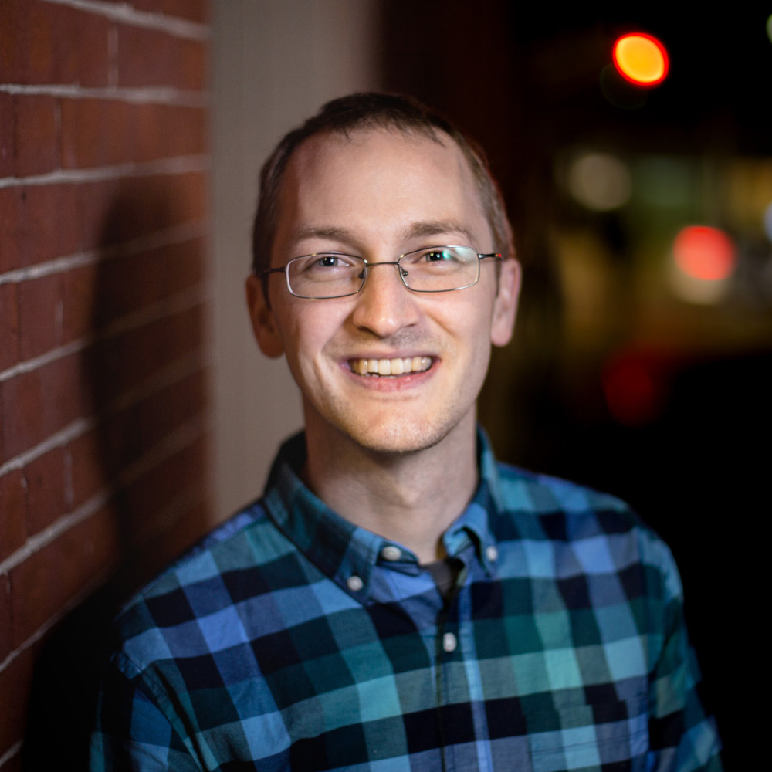
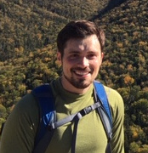
Welcome to Medlytics!
Lead Instructor
Assistant Instructor
Jordan Montgomery
MIT Lincoln Laboratory
Jeffrey Arena
MIT Lincoln Laboratory
Fun facts about me, when I was a high schooler:
I played in the high school pep-band and ran on the cross country team
My friends and I would often get together for "jam sessions" (my instrument of choice was my Roland synthesizer)
And one fact from much later than high school...
Bioshock Infinite is the most mind-blowing game I have ever played
Facts about me from when I was a high schooler:
I had 3 ACL surgeries
My favorite high school project was World War II based card game based on Magic: The Gathering
And one more from after high school...
In my free time, I enjoy playing the banjo

Slide 3
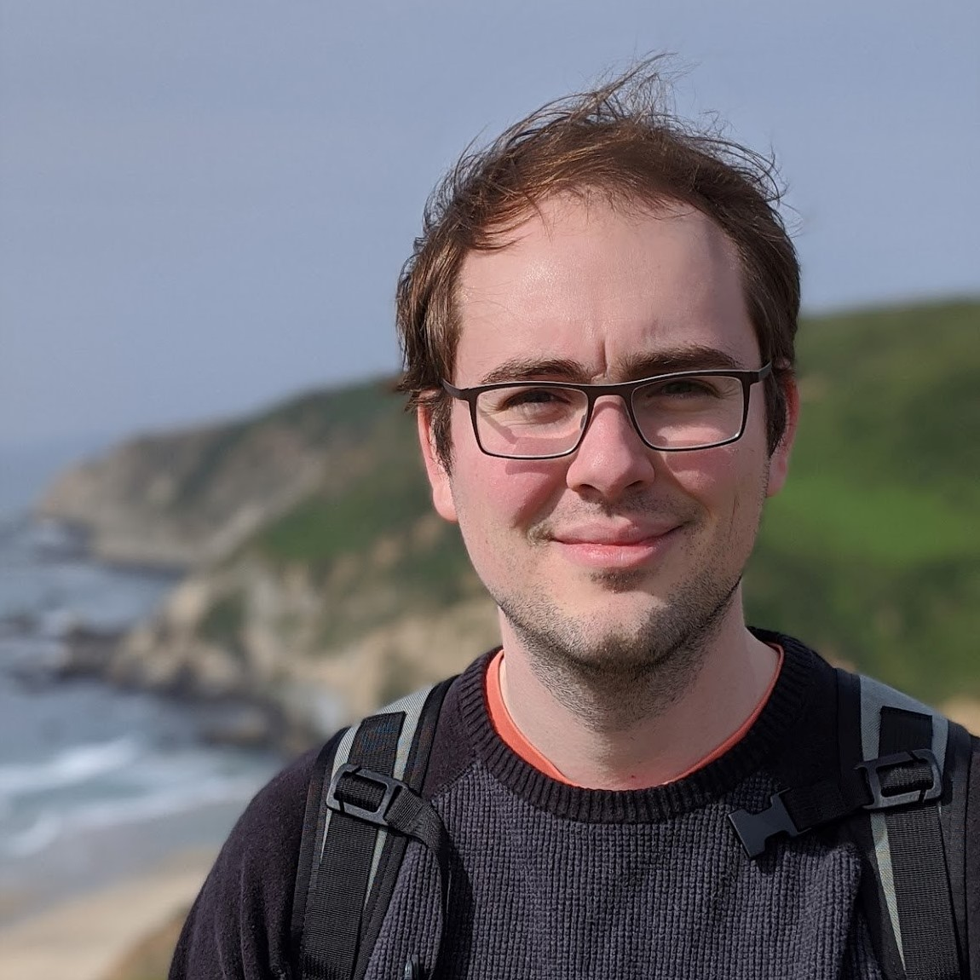
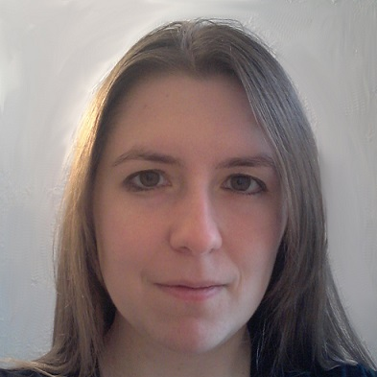
Welcome to Medlytics!
Assistant Instructor
Assistant Instructor
Thomas Curtis
MIT Lincoln Laboratory
Marianne Procopio
MIT Lincoln Laboratory
From High School
I spent all my free time at school playing card games in the cafeteria
Instead of the usual rubber band catapult, I built a string-torsion onager for physics class (no bonus points, sadly)
From Later
I bake homemade pizza every Sunday
Will be dropping in and out to help throughout the next 4 weeks!

Slide 4
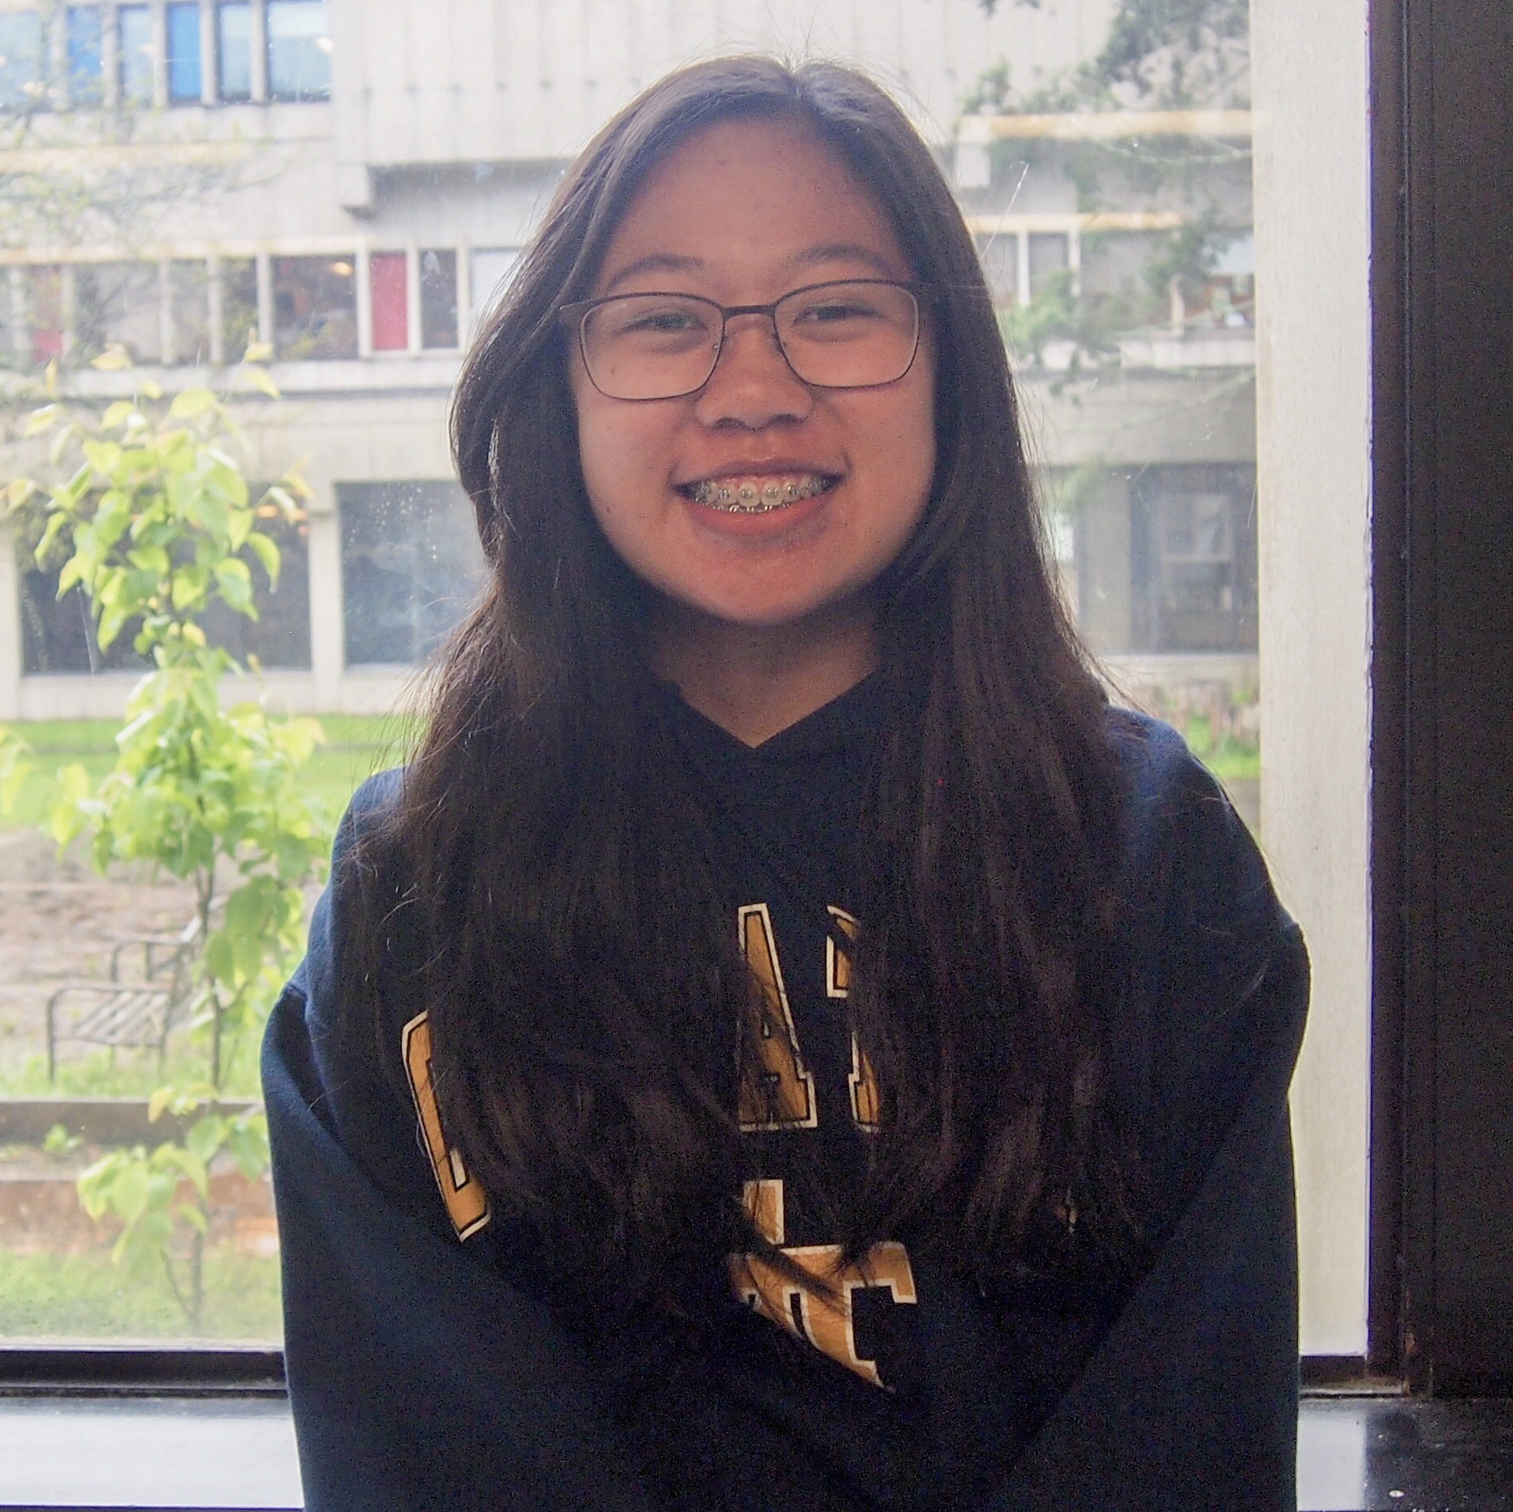
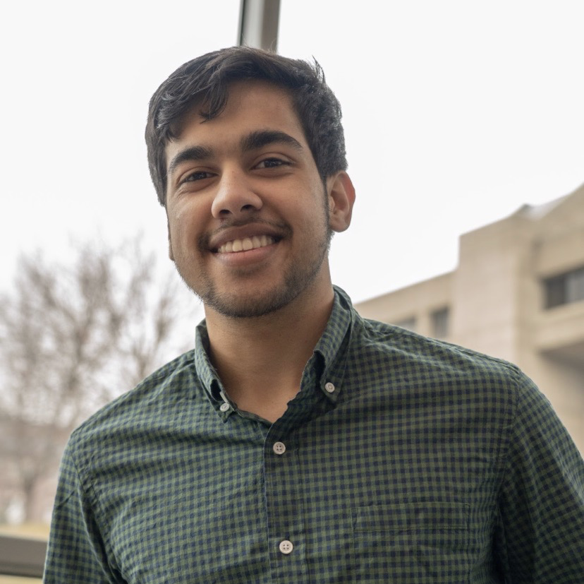
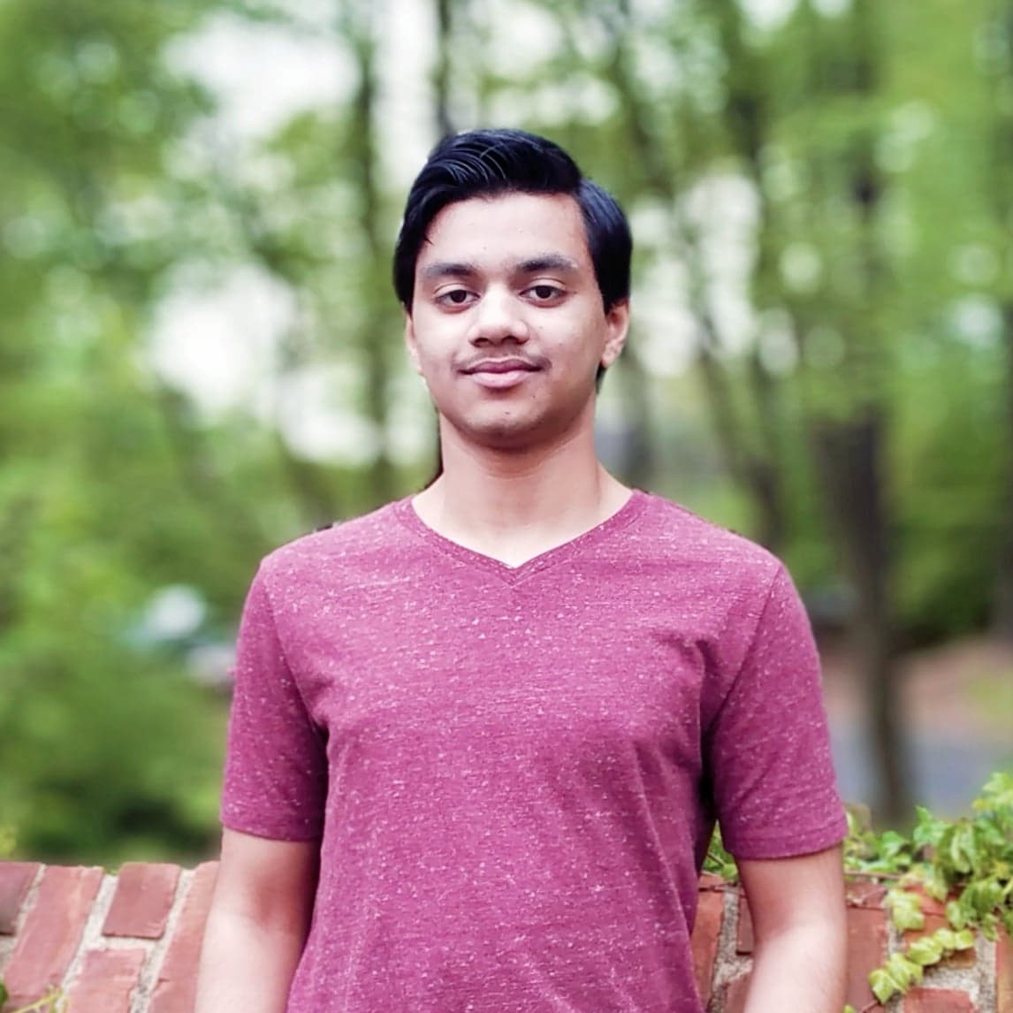
Welcome to Medlytics!
Teaching Assistants
Emily Tan
Georgia Tech
Ujwal Pandey
Rensselaer Polytechnic Institute
Sharvil Trifale
UC Berkeley
College highlights:
HackGT organizer (Operations)
Sunrise hikes, mahjong, tetris
In quarantine:
Making bubble tea from scratch (including the pearls uwu)
College highlights:
Co-Founded Putnam mathematics club
Have danced on stage with a TED onesie
In quarantine:
Been doing calisthenics!
Competed in chess tournaments (feel free to challenge me!)
love to play the violin (Favorite music piece I like to play is Pirates of the Caribbean!)
visited various National Parks (latest is Acadia National Park)

Slide 5
Weekly Schedule
Monday - Wednesday/Thursday: Lessons via interactive lectures and coding exercises
Thursday - Friday: Challenge project group work
Daily Schedule
10am – 12:30pm EST: Class time (with a guest seminar most days Weeks 1 & 2)
12:30pm – 1:30pm EST: BWSI-wide seminar
1:30pm – 2pm EST: Lunch
2pm – 5pm EST: Class time (with a guest seminar most days Weeks 3 & 4)
Office Hours
Monday - Friday: 6pm – 8pm EST
We will be answering questions in the #help channels during this time. You can still leave questions outside regular hours, but we may not be able to answer them right away.

Slide 6
Rules and Expectations
Join class on time
We’ll be taking attendance at the start of each day and after breaks.
If you need to be AFK for a few minutes for a bathroom break or anything else, you have to turn off your video and stay muted to let us know.
Be courteous, be kind – no drama!
Keep your mic muted during class sessions unless you have a question
Your dog may start barking, or your guardian might peep into your room to give you a bowl of cut fruit… It’s ok! Background noise is inevitable with everyone joining from home, so we want to minimize the number of distractions during lectures as much as possible.
Do not PM staff one-on-one
Contact us with general questions by pinging us in #general-chat with an @ mention. (@Instructor, @TA, or @ a specific person if needed)
If you’re uncomfortable sending a message or question to an entire channel, we’ve set up private channels for each of you that will only include you and TAs (an instructor can be added if requested).

Slide 7
Introductions
Preferred name
Grade
Where you’re from
1 interesting thing about yourself and/or favorite comfort food
Popcorn someone who hasn’t gone yet

Slide 8
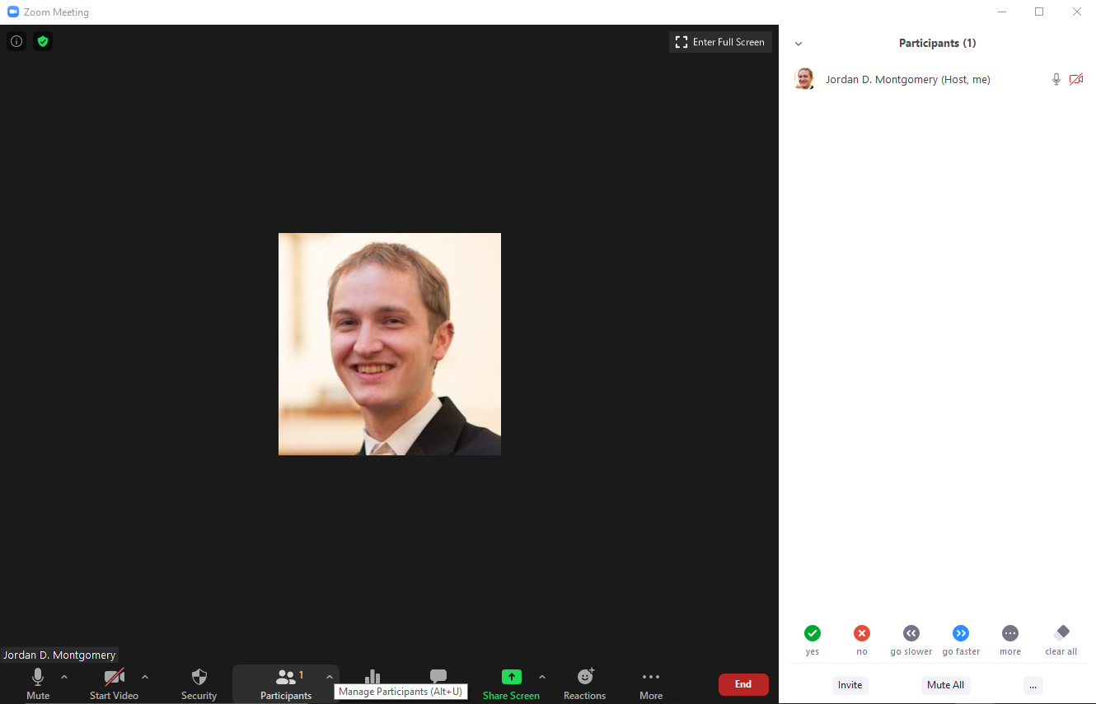
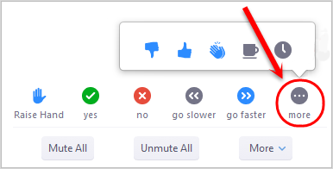
Zoom Exercises: Raising Your Hand, etc…
Click “Participants” to open up some extra options
Use the “Raise Hand” button to get instructors attention
Were you awake before 9:30 AM EDT today?
Click “yes” or “no”

Slide 9
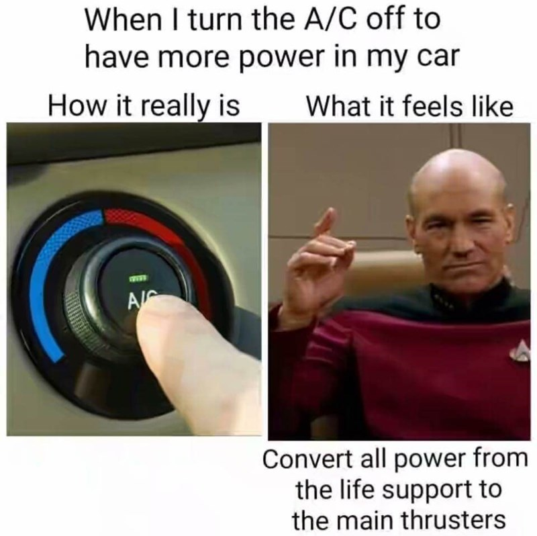

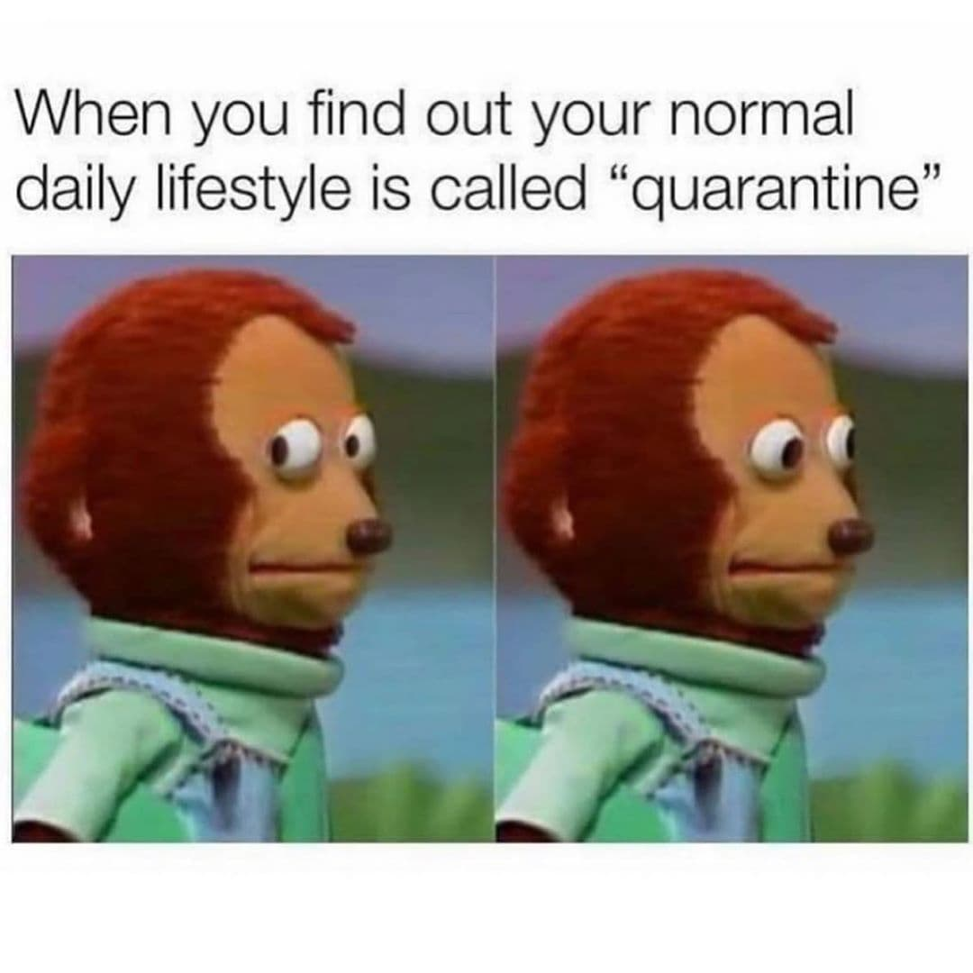
Zoom Exercises: Instructors Posting Polls
A
B
C
Which meme wins?

Slide 10
Zoom Exercises: Breakout Rooms
Instructor will send you to the breakout room
Click the link to go to your group’s Google Doc
Record your favorite breakfast food (very important research data)

Slide 11
Introductory Ice Breaker
Group 1 | Group 2
Student 1 | Student 2
Student 3 | Student 4
Student 5 | Student 6
Student 7 | Student 8
Student 9 | Student 10
Student 11 | Student 12
Student 13 | Student 14
Student 15 | Student 15
Student 17 | Student 16
Student 19 | Student 18
Student 21 | Student 20
Student 23 | Student 22
Student 25
Should I Go Outside?
Rain?
yes
no
Umbrella?
Sick?
yes
no
yes
no
Go Outside
Jacket?
Don’t go outside
Go Outside
yes
no
Go Outside
Don’t go outside

